Slide 1
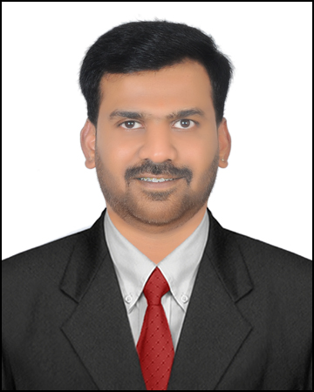
DevOps engineer
Chethan M
RELEVANT EXPERIENCE
Image Here
Enhanced CI/CD processes by defining and managing build and release pipelines. Implemented
container-based deployments using Docker, including creating Dockerfiles, managing images, and
maintaining registries.
Created GKE clusters according to client specifications across multiple environments, both manually and
using Terraform, and writing Kubernetes manifests to create Kubernetes objects and services such as
Ingress.
Strong experience with Amazon Web Services(AWS) encompassing virtual machines, networking, storage,
and other cloud services.
Deployed Kubernetes objects using GitOps methodology and integrated continuous integration tools.
Skilled in writing Terraform scripts using modules.
chethanm@deloitte.com
Experienced DevOps Engineer with 1 year and 11 months of experience and a strong background in Linux, Jenkins, Docker, Kubernetes, AWS and GCP. Specializes in creating and developing automation scripts and is proficient in Linux administration tasks.
Technical skills: GitHub, Jenkins, Docker, Kubernetes, Terraform, AWS, GCP, Linux.
Business Skills: Communication, Collaboration and Strategic Thinking.
RELEVANT SKILLS
EDUCATION/CERTIFICATIONS
VTU UNIVERSITY , B Tech (CSE)
CKA (Certified Kubernetes Administrator)

